Slide 1
Machine learning for sub-genre classification

Slide 2
Contents
Visualising audio
Extracting information from audio
Thesis
Machine learning
Deep learning
Training
Results
Discussion
Convolutional neural networks

Slide 3
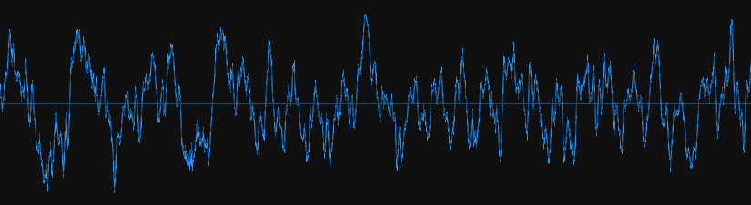
Visualising audio
Amplitude
~30 ms
Time

Slide 4
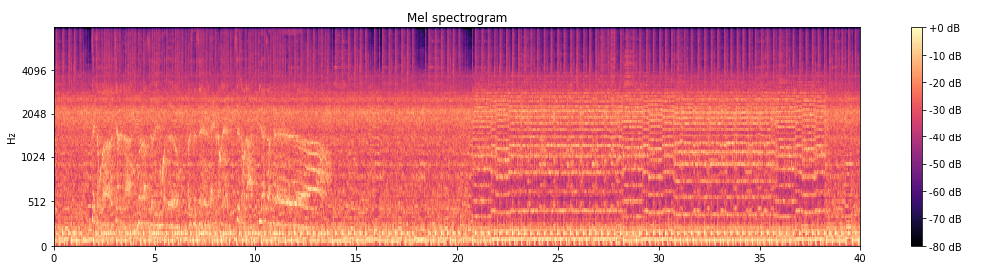
Visualising audio
Frequency
Time (s)

Slide 5
Visualising audio

Slide 6
Visualising audio
Vocals
Shredding
Drums

Slide 7
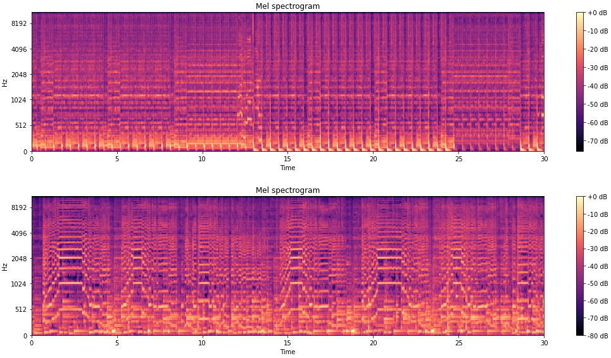
Visualising audio
Genre 1
Genre 2

Slide 8

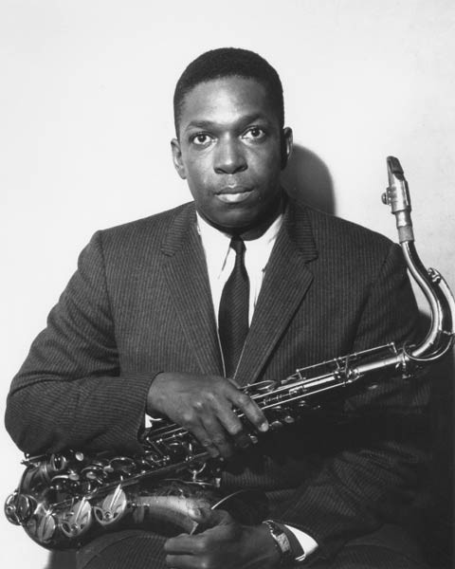
Visualising audio
Daft Punk
John Coltrane
Notes:
There’s two ways to easily determine the genre of music. 1) learn the features of this spectrogram (this requires an ability to generalise which classical machine learning can’t do) or 2) distil the information in the spectrogram into a more compact but descriptive form.

Slide 9
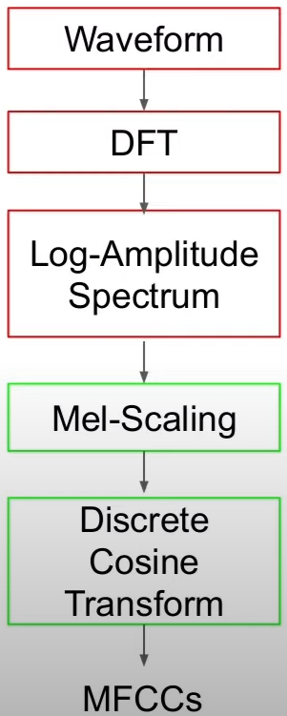
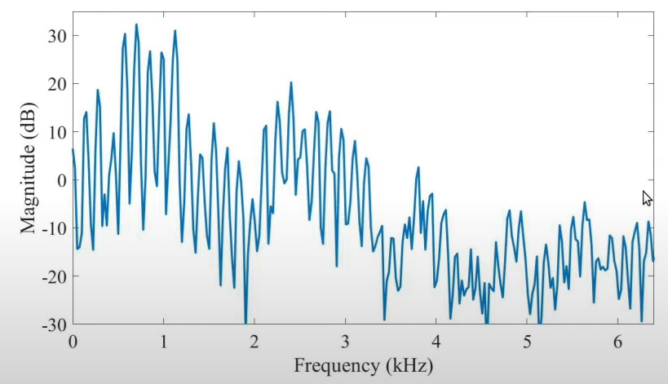
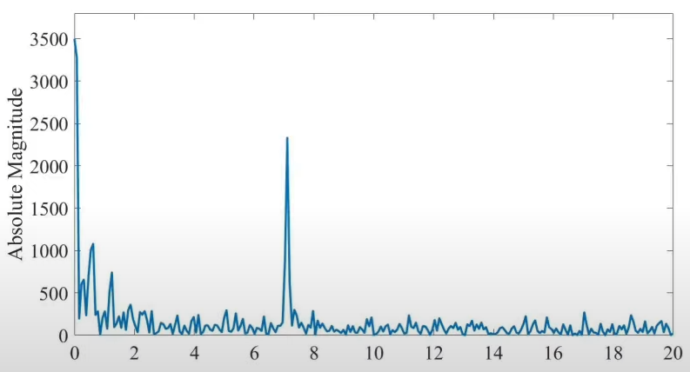
Extracting information from audio
waveform
spectrum
spectrum of a spectrum
Notes:
Harmonic structure in spectrum is described as the large peak in the cepstrum.

Slide 10
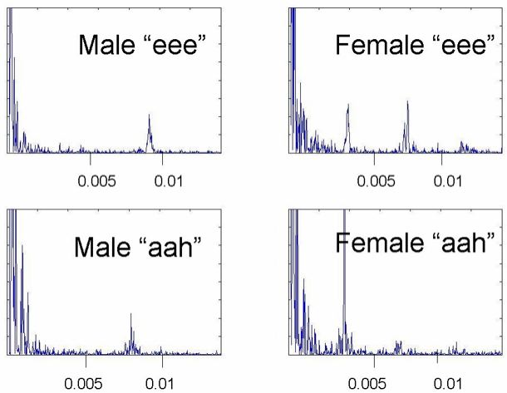
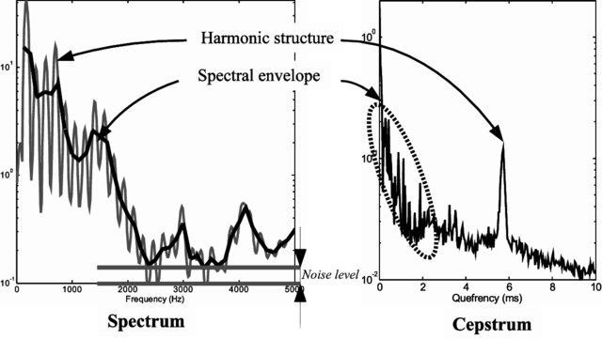
Extracting information from audio

Slide 11
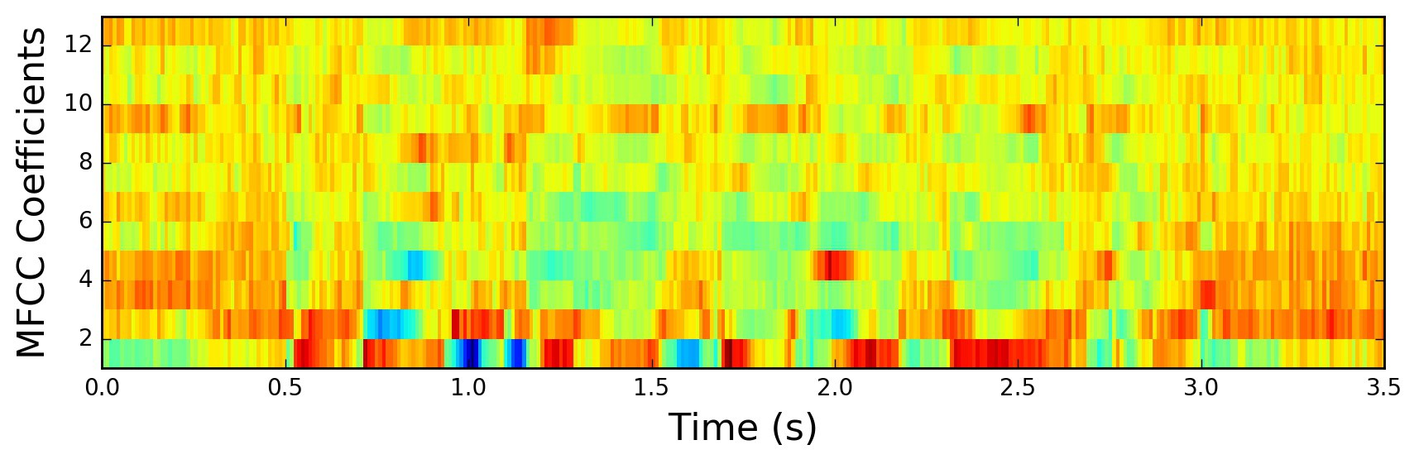
Extracting information from audio
Notes:
These few values are the most compact way to describe the formants for a speaker which can be used to identify them. This power translates to music.

Slide 12
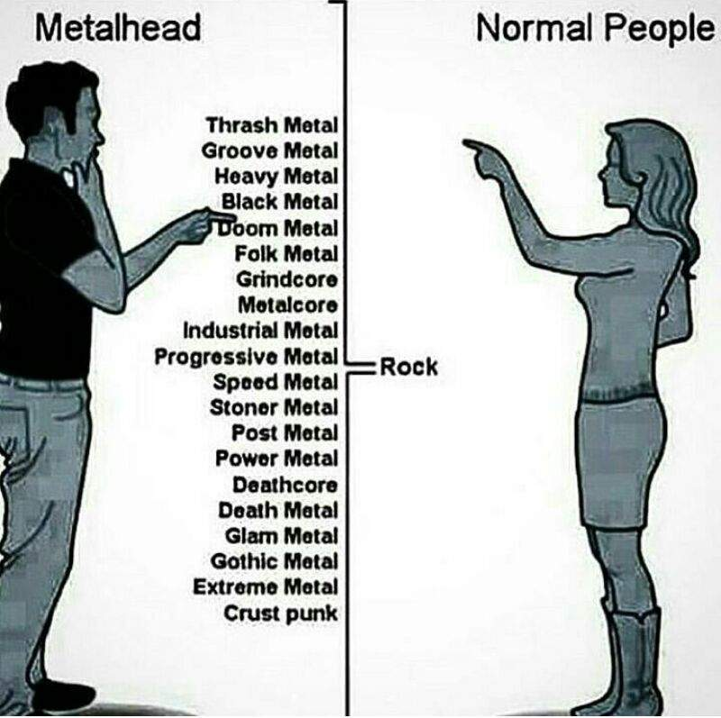
Thesis

Slide 13
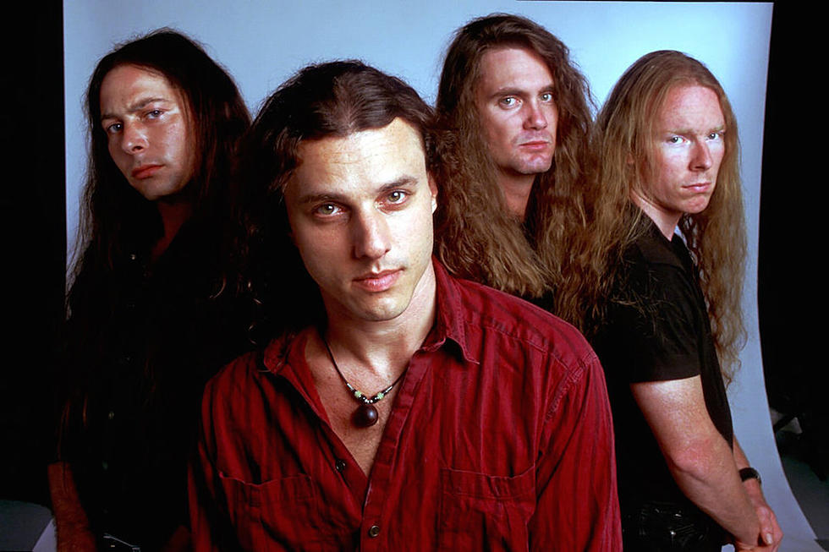
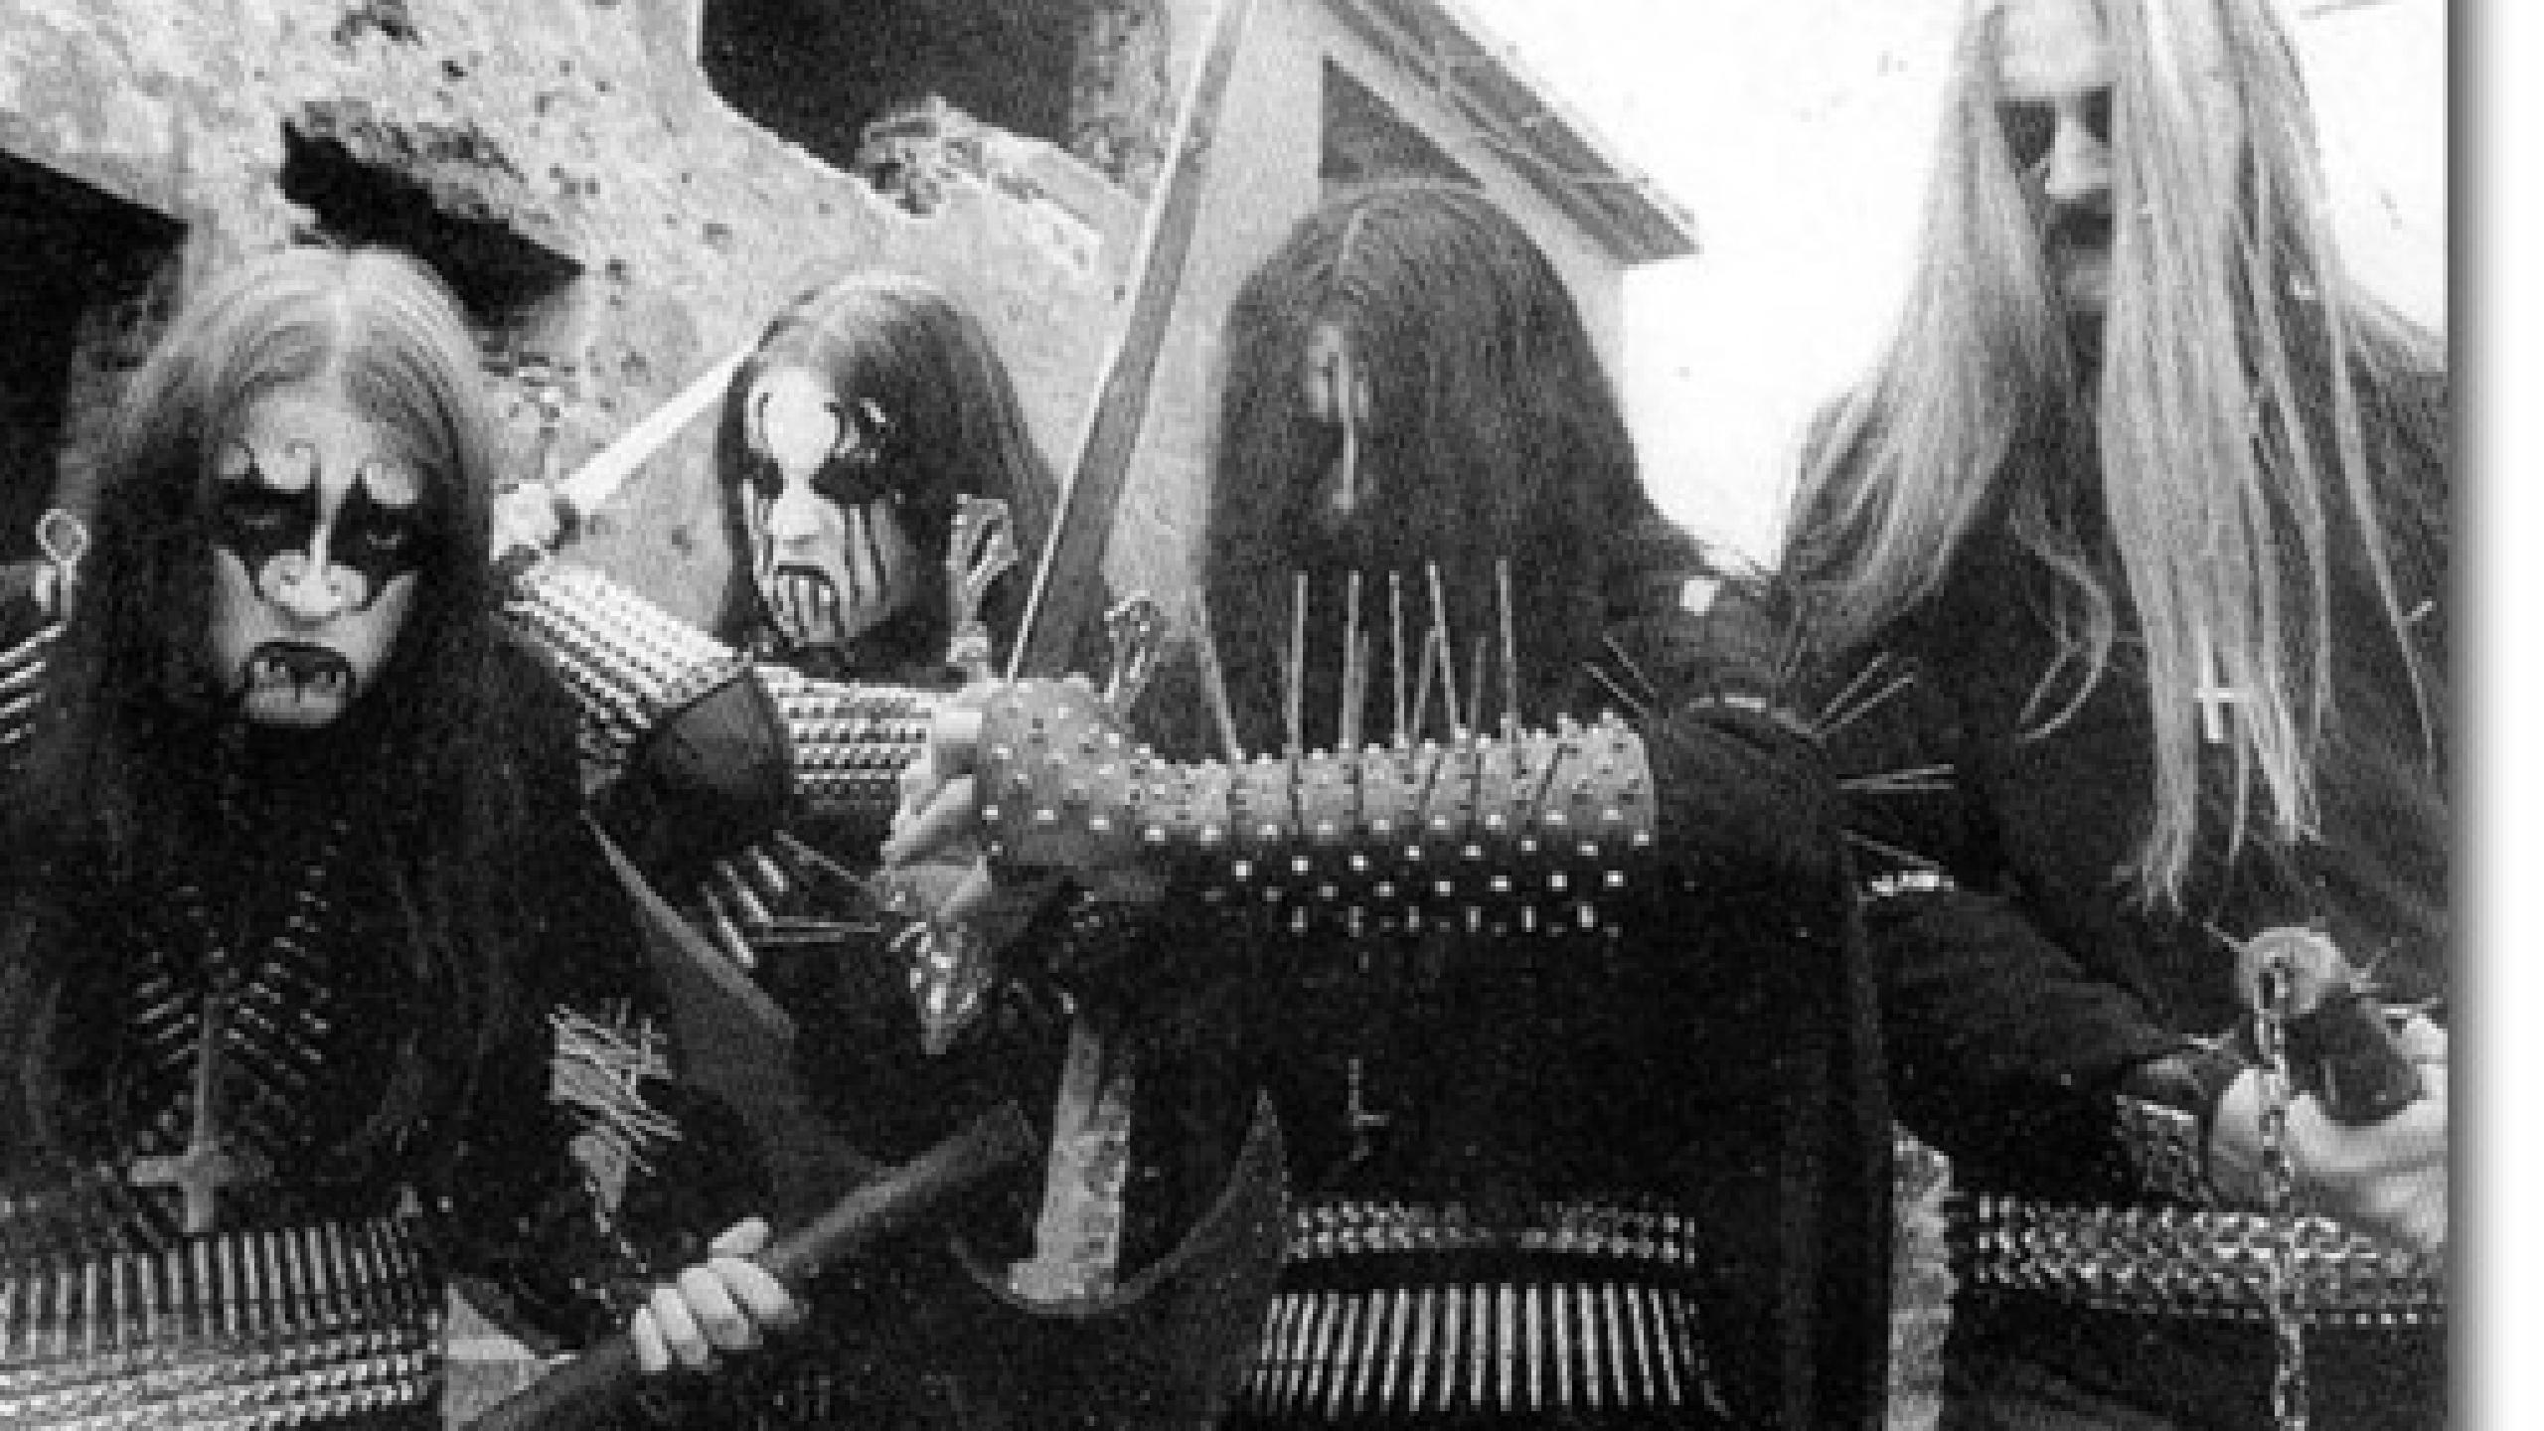
Thesis
Floridian Death Metal (1980s)
Norwegian Black Metal (1990s)

Slide 14
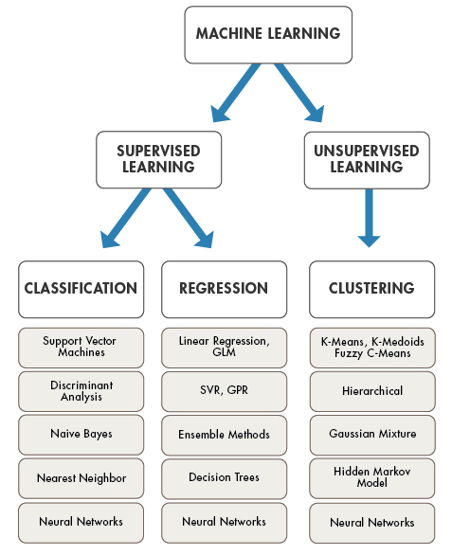
Machine learning
“A computer program is said to learn from experience E with respect to some class of tasks T and performance measure P, if its performance at tasks in T, as measured by P, improves with experience E.”
Mitchell, T. M (1997). Machine Learning.
McGraw-Hill, New York.

Slide 15
Machine learning - classification
Training process
Adjust parameters
Labelled training data
Mathematical Model
Classifications
Loss value
Evaluation process
Test data
‘Trained’ Mathematical Model
Classifications

Slide 16
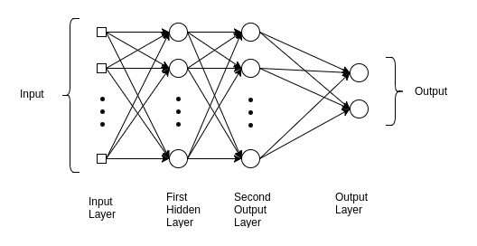
Deep learning

Slide 17
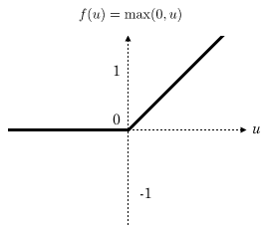







Deep learning
$$ω_{1}$$
$$a$$
$$x_{1}$$
$$x_{2}$$
$$ω_{2}$$
ReLU
$$z=ω_{1}x_{1}+ω_{2}x_{2}+b$$
$$a=ReLU(z)$$

Slide 18
Training
Spectral centroid
Spectral roll-off
Spectral flux
Spectral contrast
Spectral bandwidth
Spectral flatness
Zero crossing rate
Root-mean square energy
Sample silence
13 MFCCs
Tempo
62 black metal songs
229 death metal songs
134 audio features extracted
x 6 statistical summary values over the entire sample time

Slide 19
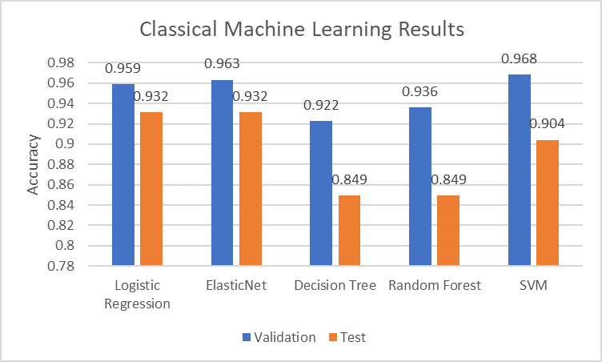
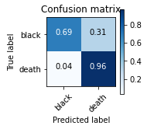
Results

Slide 20
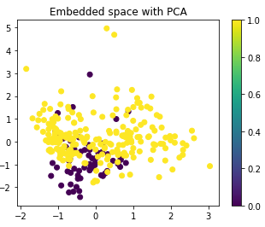
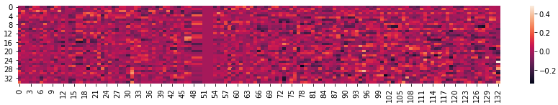
Discussion
MFFC_6_Skew
Tempo

Slide 21
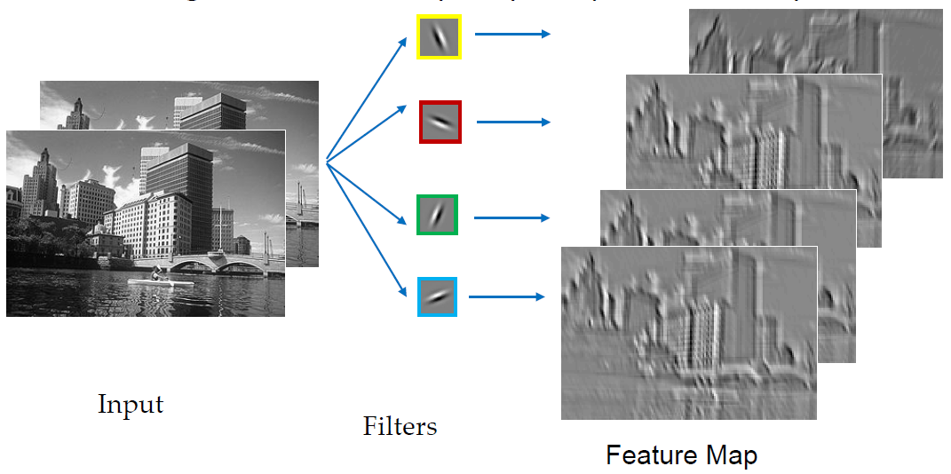
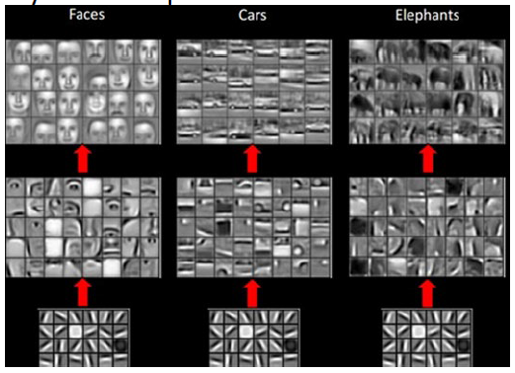
Convolutional neural networks

Slide 22
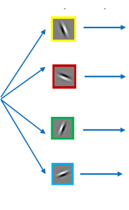
Convolutional neural networks
Black metal
…
Death metal

